Slide 1
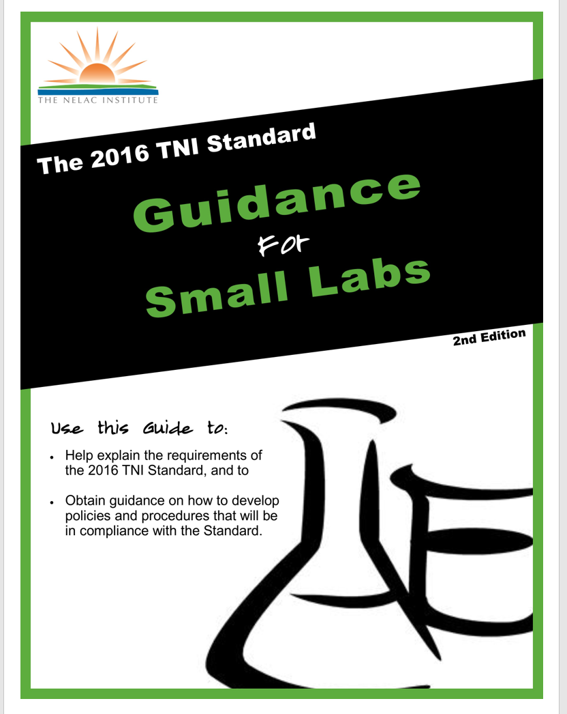
TNI Small Laboratory Handbook

Slide 2
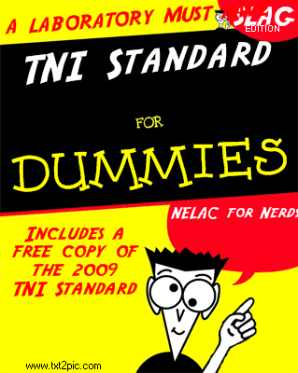
The Initial Inspiration…

Slide 3
The Initial Inspiration…
Guidance Manual
for
Laboratories
Seeking
NELAC
Accreditation
by
Thomas W. McAninch, PhD
Laboratory Consulting Services

Slide 4
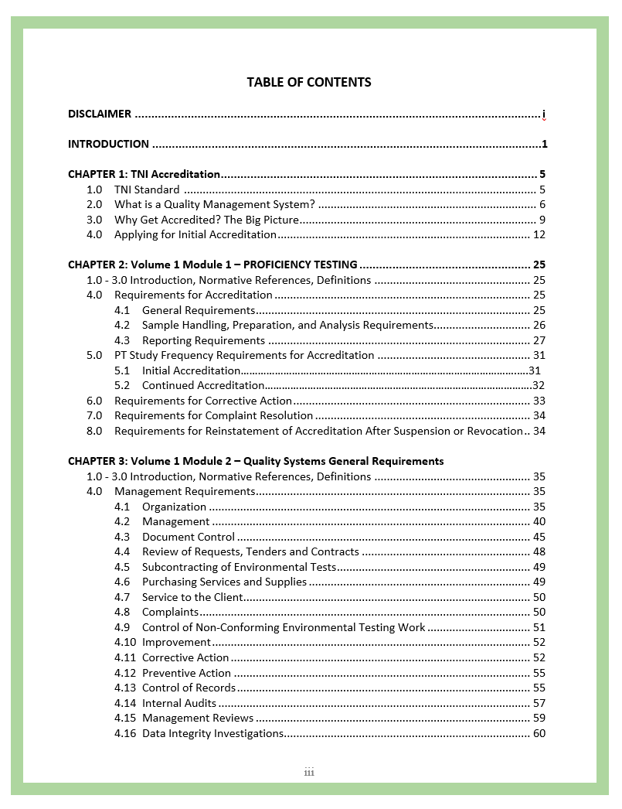
Contents Match TNI Standard Outline

Slide 5
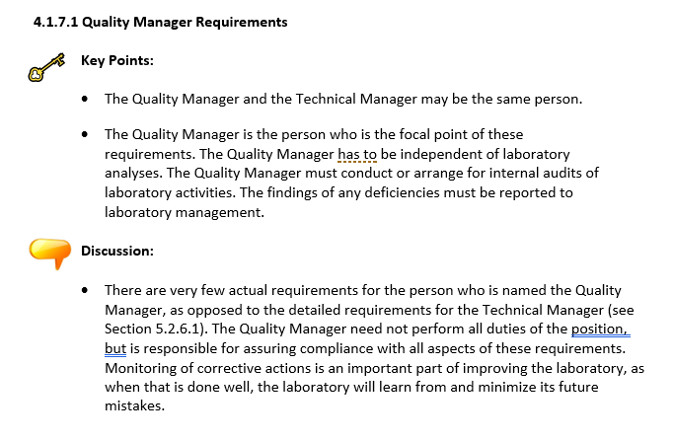
Includes Key Points and Discussion

Slide 6
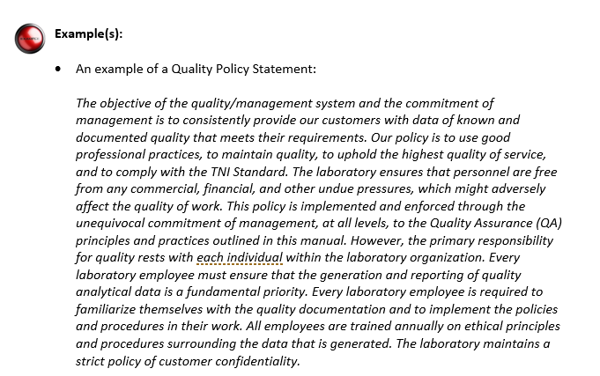
Examples are included

Slide 7
Appendices
Common Findings
Standard Interpretations
Guidance Documents (to be added fall 2018)
SOP Templates

Slide 8
Guidance Documents
Proficiency Test Reporting Limit
Limit of Detection and Limit of Quantitation for Chemistry
Instrument Calibration for Chemistry

Slide 9
SOP Templates
Administrative and Technical SOPs
Describe how to do them
Includes examples for TSS and Internal Audits

Slide 10
Summary:
Many years of experience are included in hopes that the small laboratory will be spared a fair amount of learning from the mistakes of others.
It should also benefit the assessors by making laboratories more prepared for their first assessment

